Slide 1

Organic Outlook:
Keys to Success
Amy
Bruch
Contact for more Information
Amy@CycloneFarmsInc.com
www.cyclonefarmsinc.com
Twitter: @cyclonefarms

Slide 2
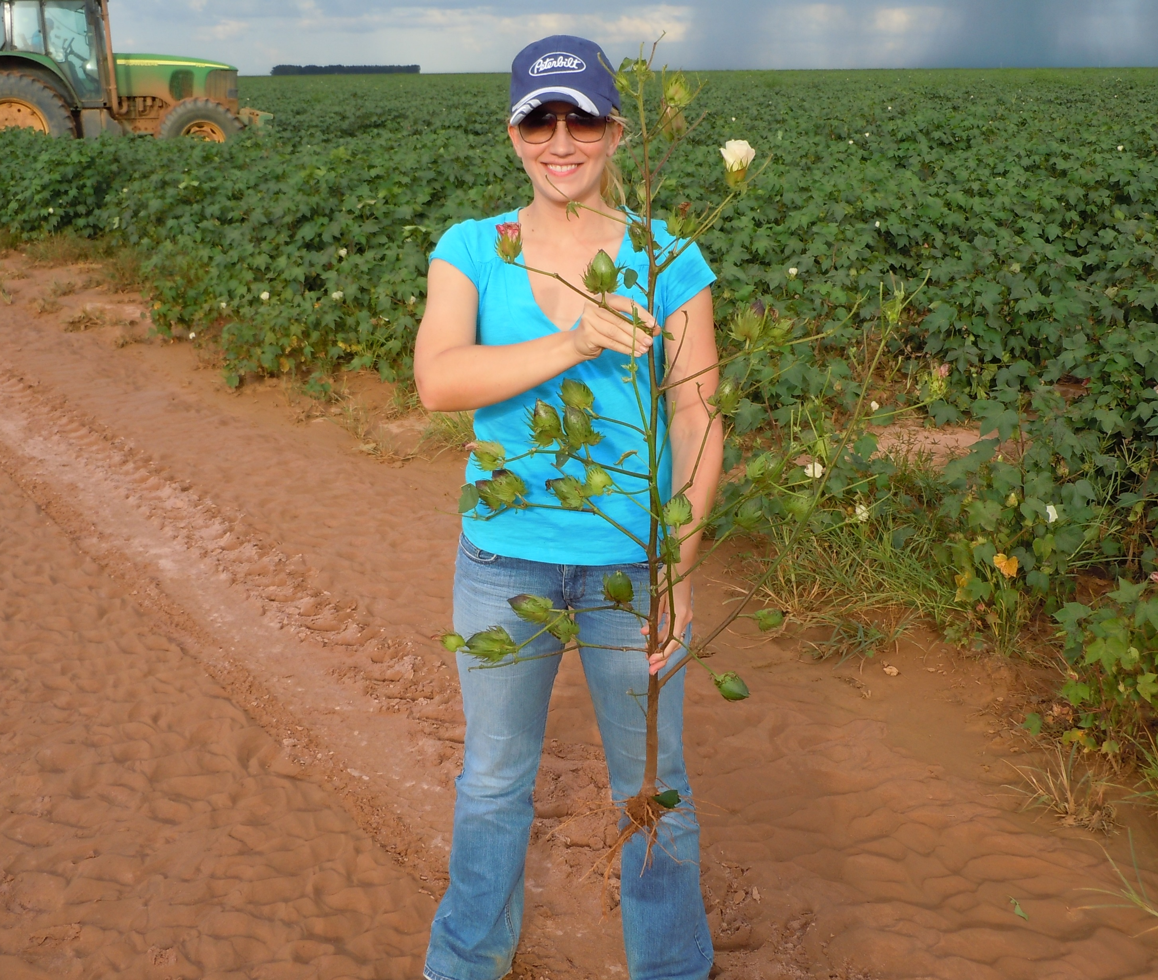

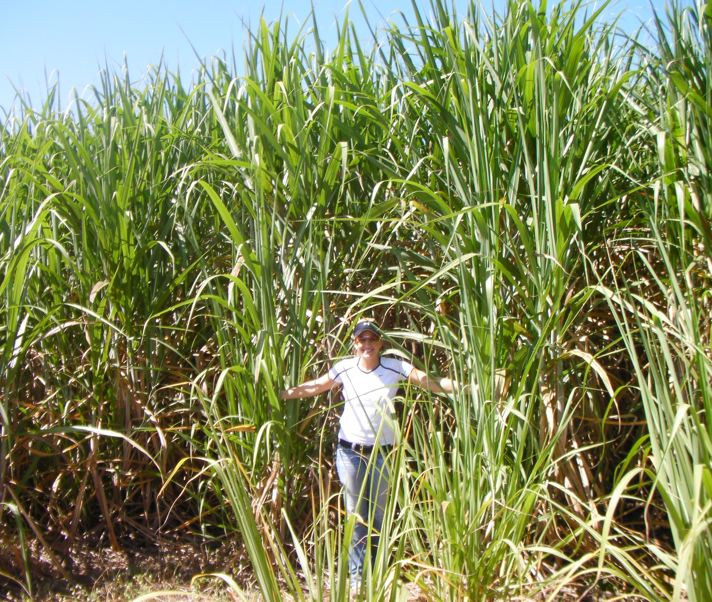
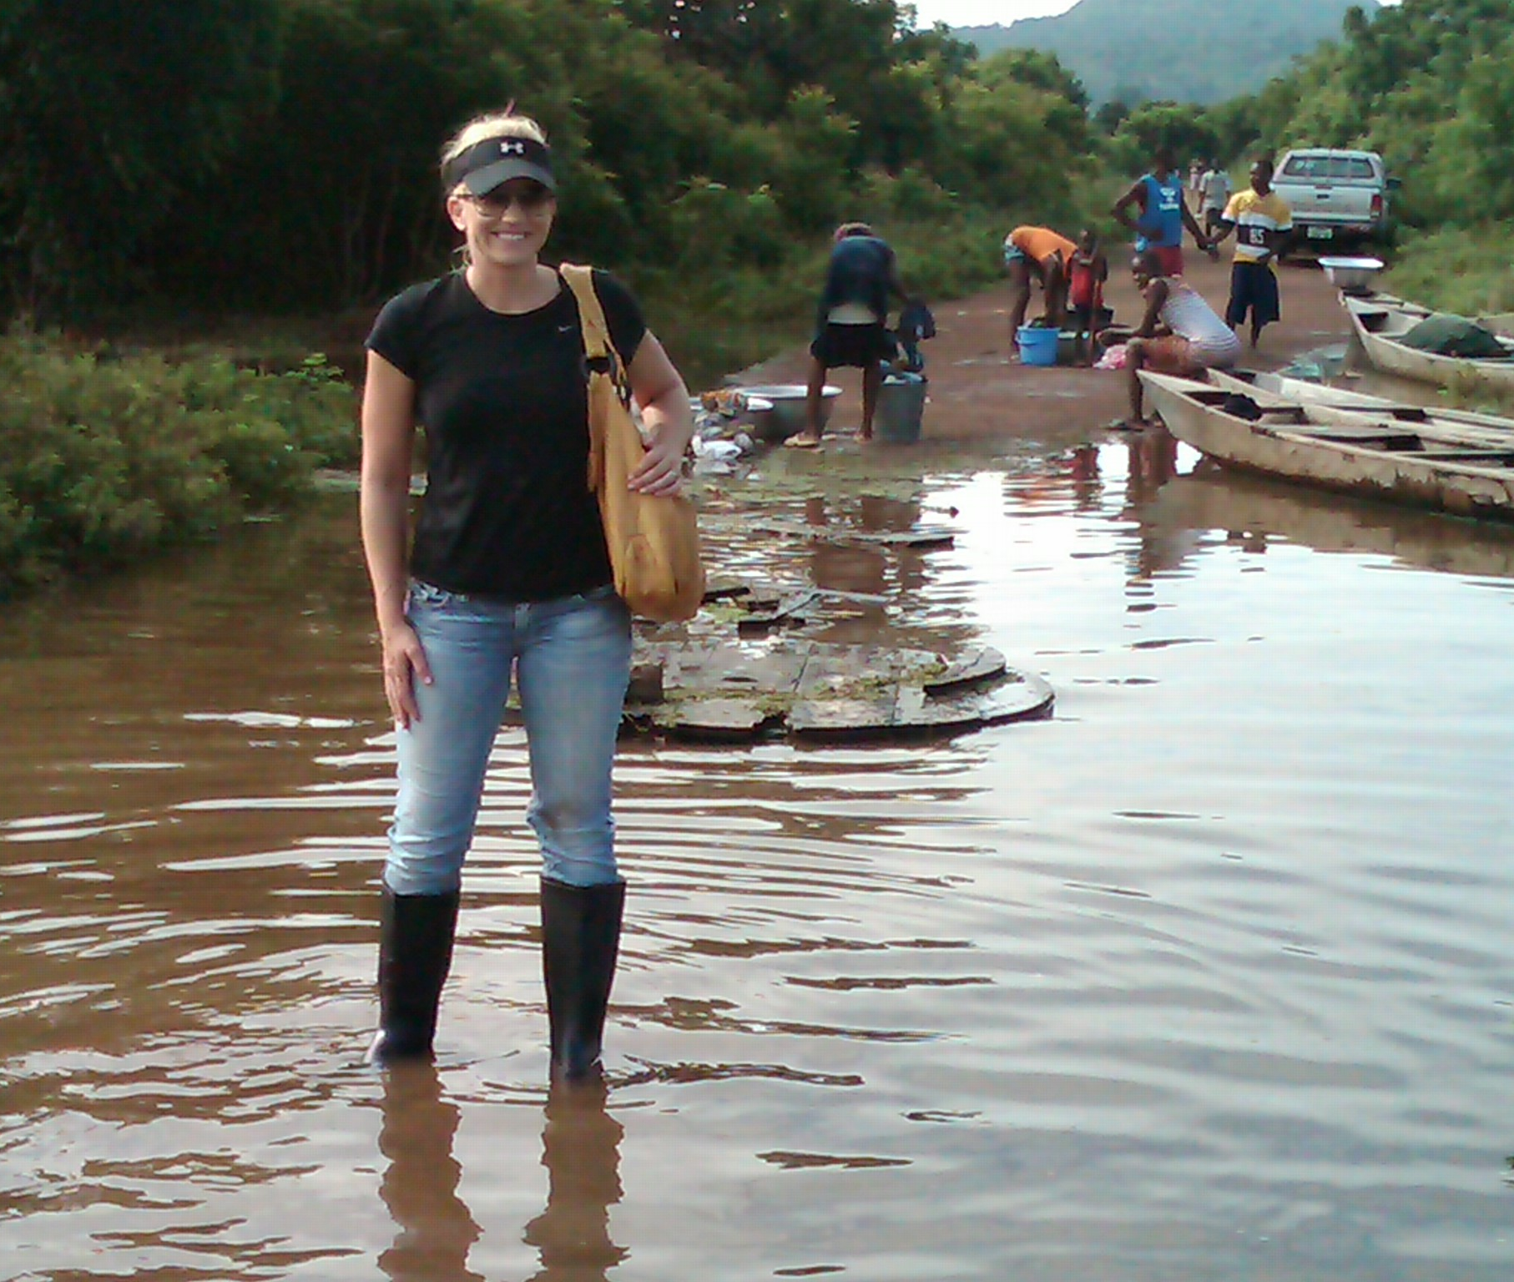
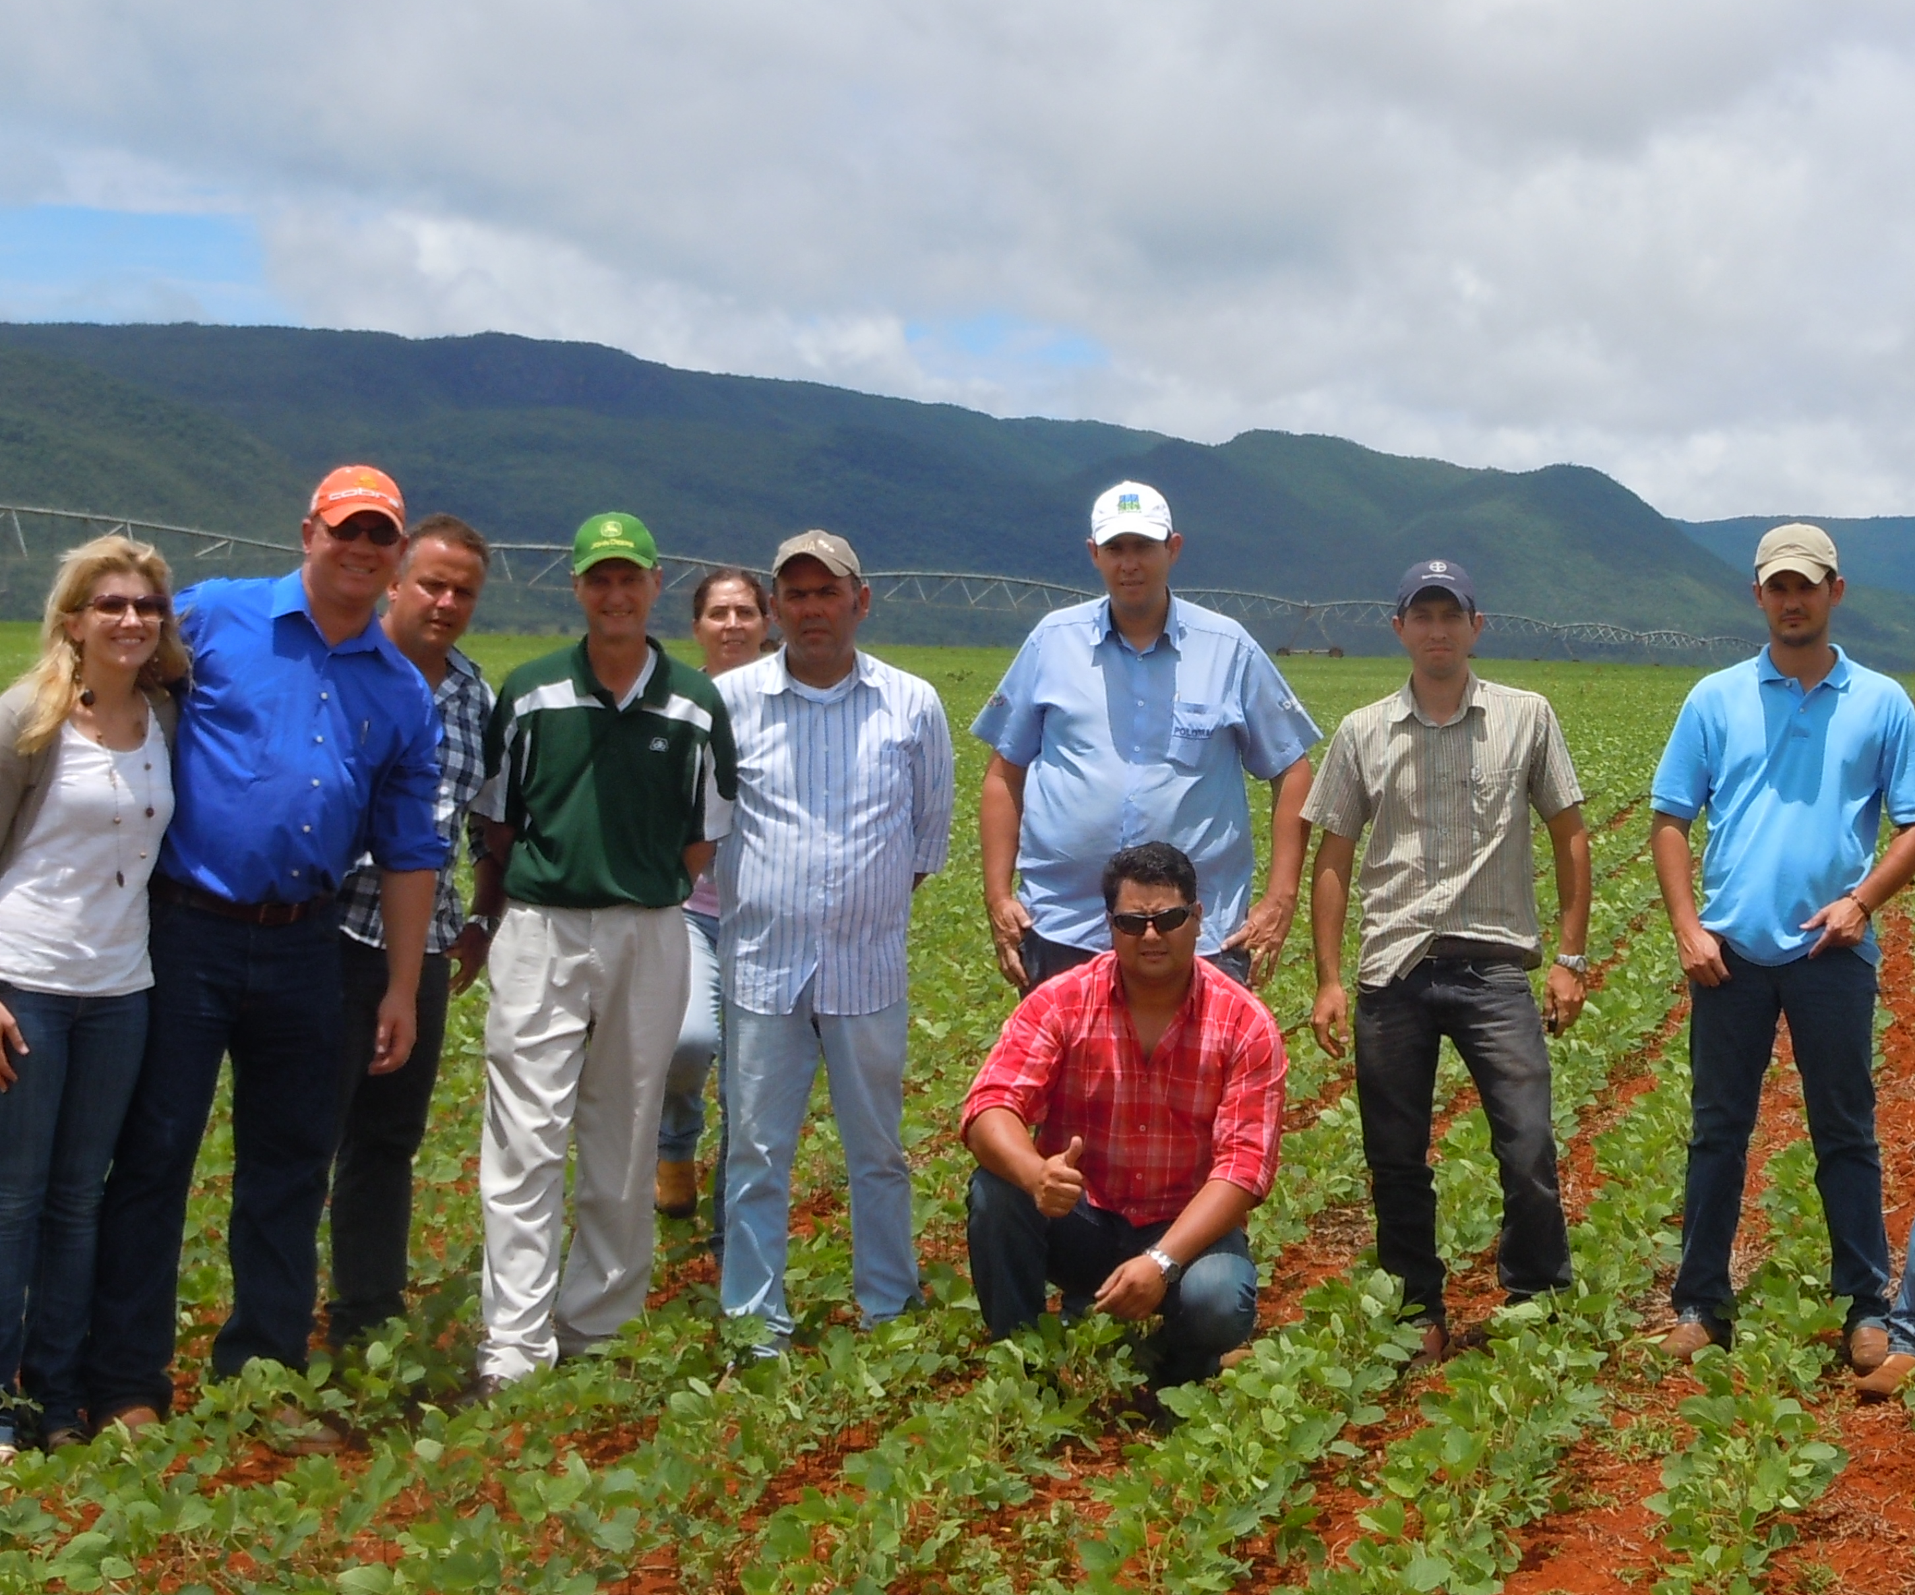
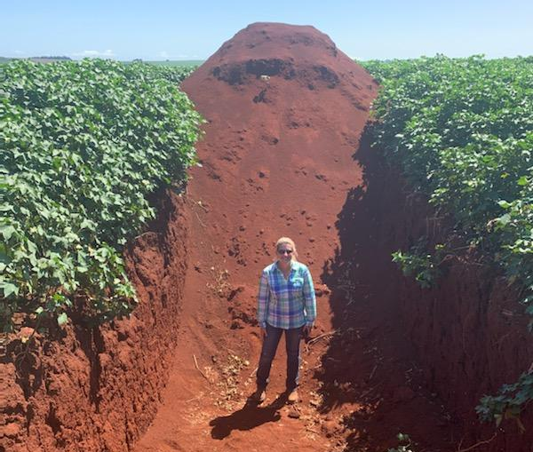

Slide 3
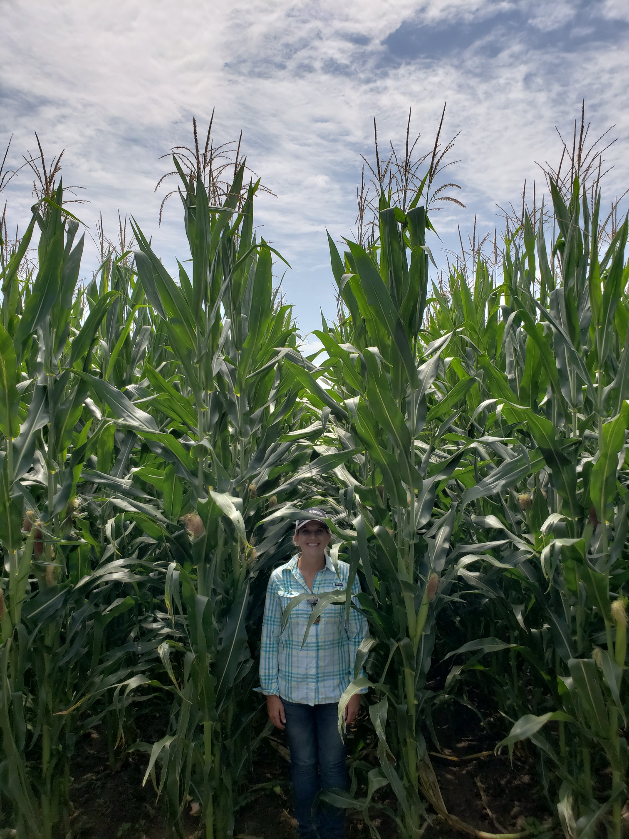

Long Term Balance is Key to Success in Organic Production
Organic Yellow Corn
Agronomic
Economic
Managerial

Slide 4

Organic Decisions: System & Process Based
Organic farming requires a myriad of decisions
Crop Rotation
Delivery
Fertility Needs
Storage
Weed Management
Application
Crop Management
Fertility
Record Keeping
Weather Forecast
Cover Crop
Capacity
Working Capital
Certification
Marketing
Counterparty Risk
Identification
Risk Management Approach
Record Keeping
Storage
Delivery
Cash Flow

Slide 5
BARRIERS to SUCCESS
Barriers to entry are driven by limited support from traditional sources
Growth challenges are driven by greater operational requirements
Transition Barriers
Scaling Challenges
Organic Production Knowledge
Operational Complexity & Scalability
Evaluating & Financing Transition
Technology
Certification & Recordkeeping
Attractive Crop Options for Rotations
Market Options
Labor
Risk Management & Regulatory
Supply Chain & Market Stability

Slide 6
Financing the Transition
Challenge: Economics of Transition Opportunity: Strike the Right Balance
Economic Impact
Low
High
High
25-35%
of target acres per year
Too Few
(minimal economic benefit)
Key Factors
Crop Rotation
Access to Labor
Farm Balance Sheet
Support Systems
Ability to Execute
Wrong Plan
or
Wrong Fields
or
Wrong Equipment
Too Many Acres
(potential for negative $$ impact)
Low

Slide 7
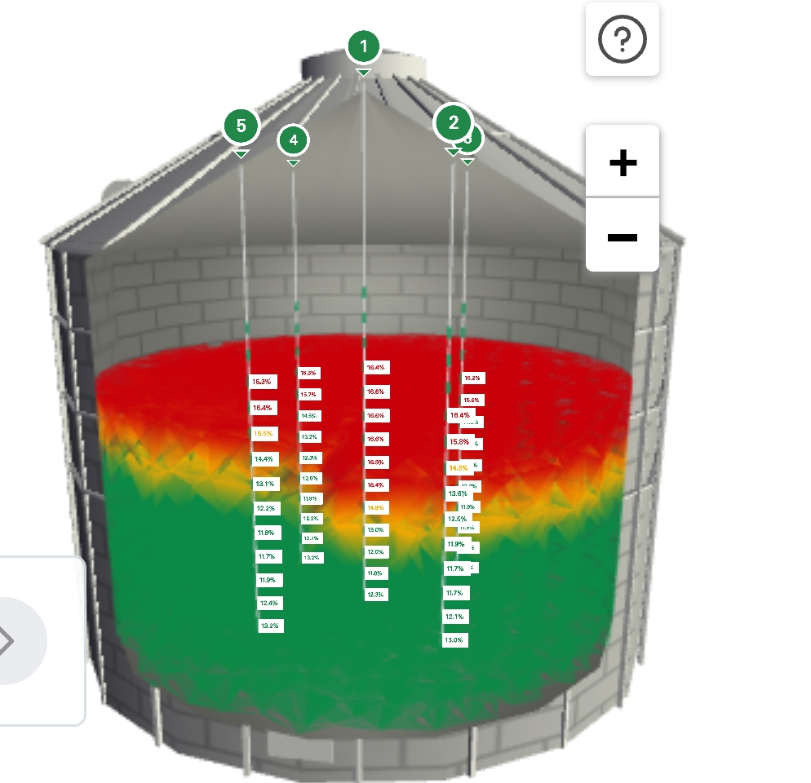
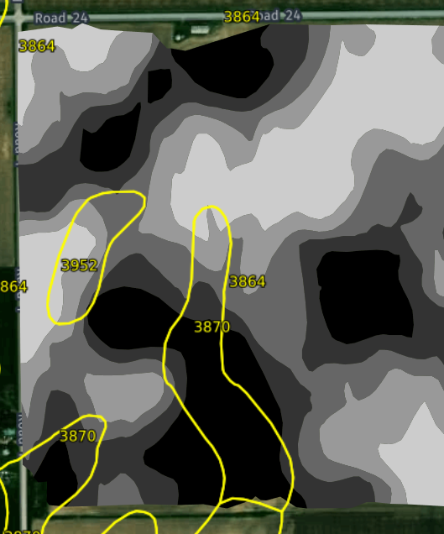
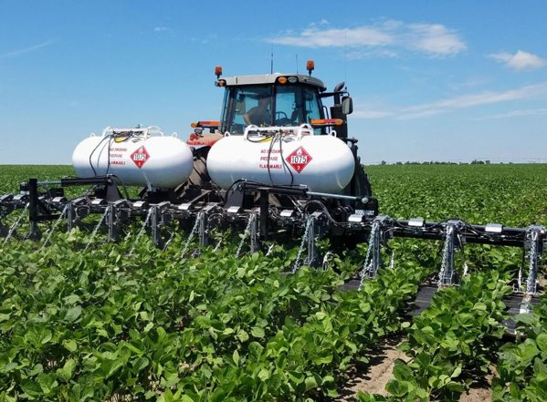
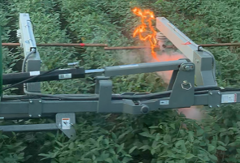
Technology
Challenge: Capital Requirements for Technology Integration
Opportunity: Insight, Multiple modes of Actions, & More Consistent Outcomes
  Advanced Agronomics & Consistency - Soil is our Number 1 Defense
  Rainy weather Defense & Tillage reducer
  Defense against late season weeds
  Insight is key defense for long term storage
1. Soil Zones: Electro-Conductivity
2. Weed Flaming
3. Weed Electrocution – 14,000V
4. Storage Management

Slide 8
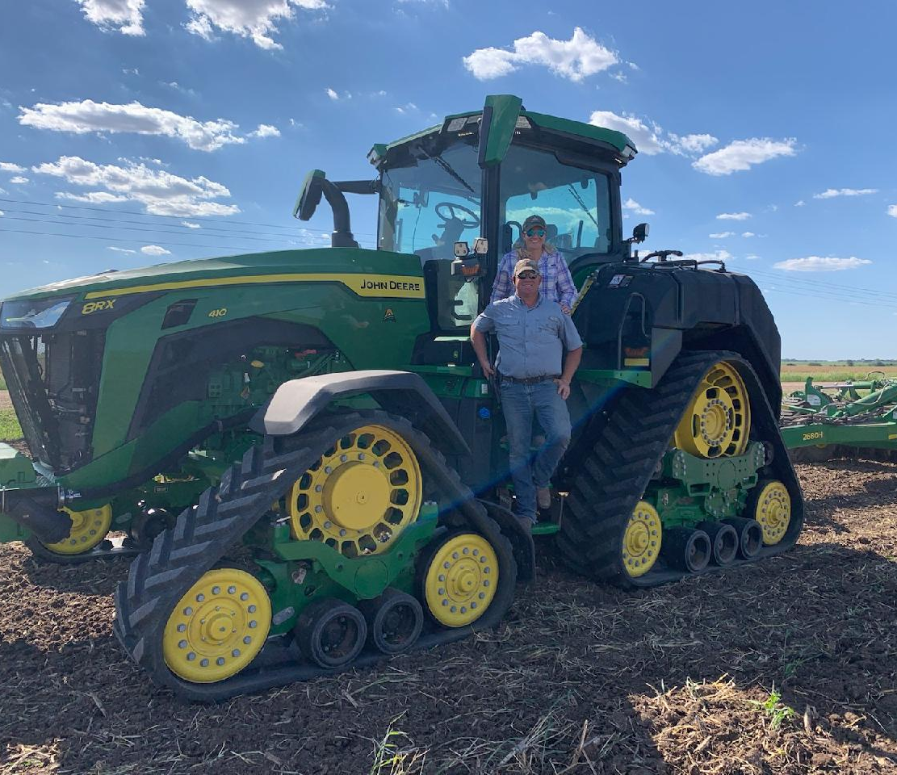
Labor
Framework: 36, 3, 365
Challenge: Labor
Opportunity: Pathway to Return to the Farm
  Specialized Training
    Character first
    Direct and indirect positions
  Long-Term Investment
    Create ownership environment
    Goal: our employees are multi-generational
      health, 401k, vacation, etc.

Slide 9
Regulatory & Risk Management
Multi-Peril Insurance Coverage Example
Need Adequate Coverage:
  Challenge: Transition & Organic T-yields
  Opportunity: Policy Acceleration Needed for Production and Revenue History (PRH)
    producer’s own yield and price history
    Introduced in 2021 in Strawberries - FL
Need Organic Adjusting Standards:
  Challenge: Organic Food Grade Crops Adjusted to Conventional Feed Grade Standards
  Opportunity: Organic Adjusting Standards
Note: Whole Farm Protection Challenge - Not applicable for farmers with less than 5 years tax history
CORN | CONVENTIONAL | TRANSITION
APH (approved production history) | 210 | 135 (t-yields)
Price ($/Bu) | $4.45 | $4.45
% Coverage | 85% | 85%
Insurance Coverage | $794.32 | $510.64

Slide 10
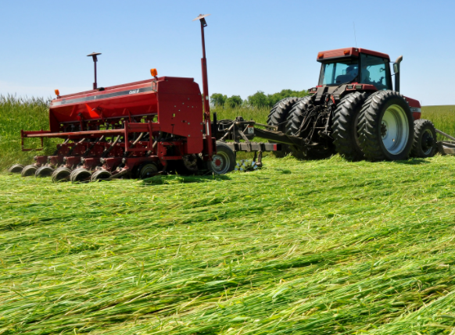
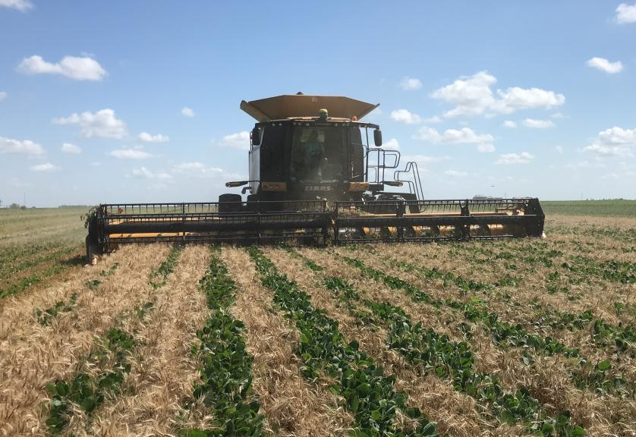
Regulatory & Risk Management:
Climate Smart Practices are “Good”
Challenge: Intercropping & Roller Crimping Not Widely Accepted
Strategic deployment of cover crops
Opportunity: Expand Good Farming Practices to Include Climate Smart Techniques
Interagency Consistency:
Challenge: RMA Requires Transition System Plans when the NOP does not have Official Standards for Transition
Opportunity: Match Expectations within the USDA Umbrella for Transition Requirements
Dicamba Impact:
Challenge: Point of Source is Nearly Impossible to Identify
Large losses incurred absorbed solely by impacted transition/organic farmer
Opportunity: Open to any Solutions to Reduce Loss Impact
Roller Crimper
Inter-Cropping

Slide 11
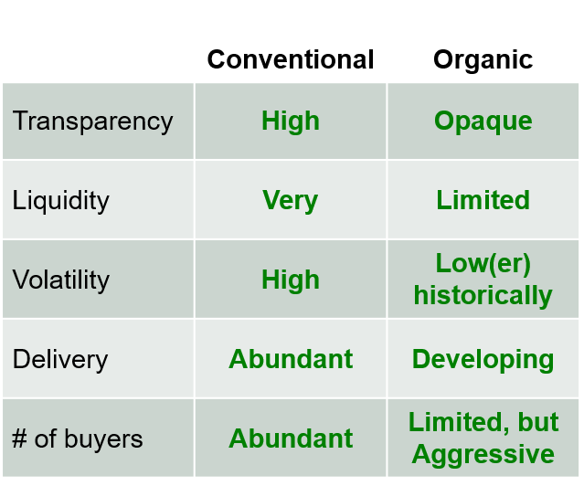
Supply Chain
Market Comparison
Organic Production - No longer a Niche
  Organic Market Place = $62B
  Conventional Corn Crop = $75B
Challenge: US is Organic Net Importer
Opportunity: Grow Domestic Organic Production

Slide 12
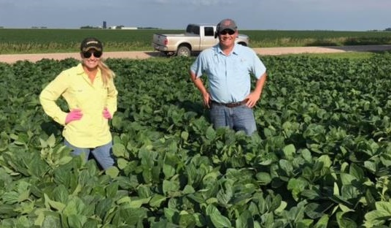
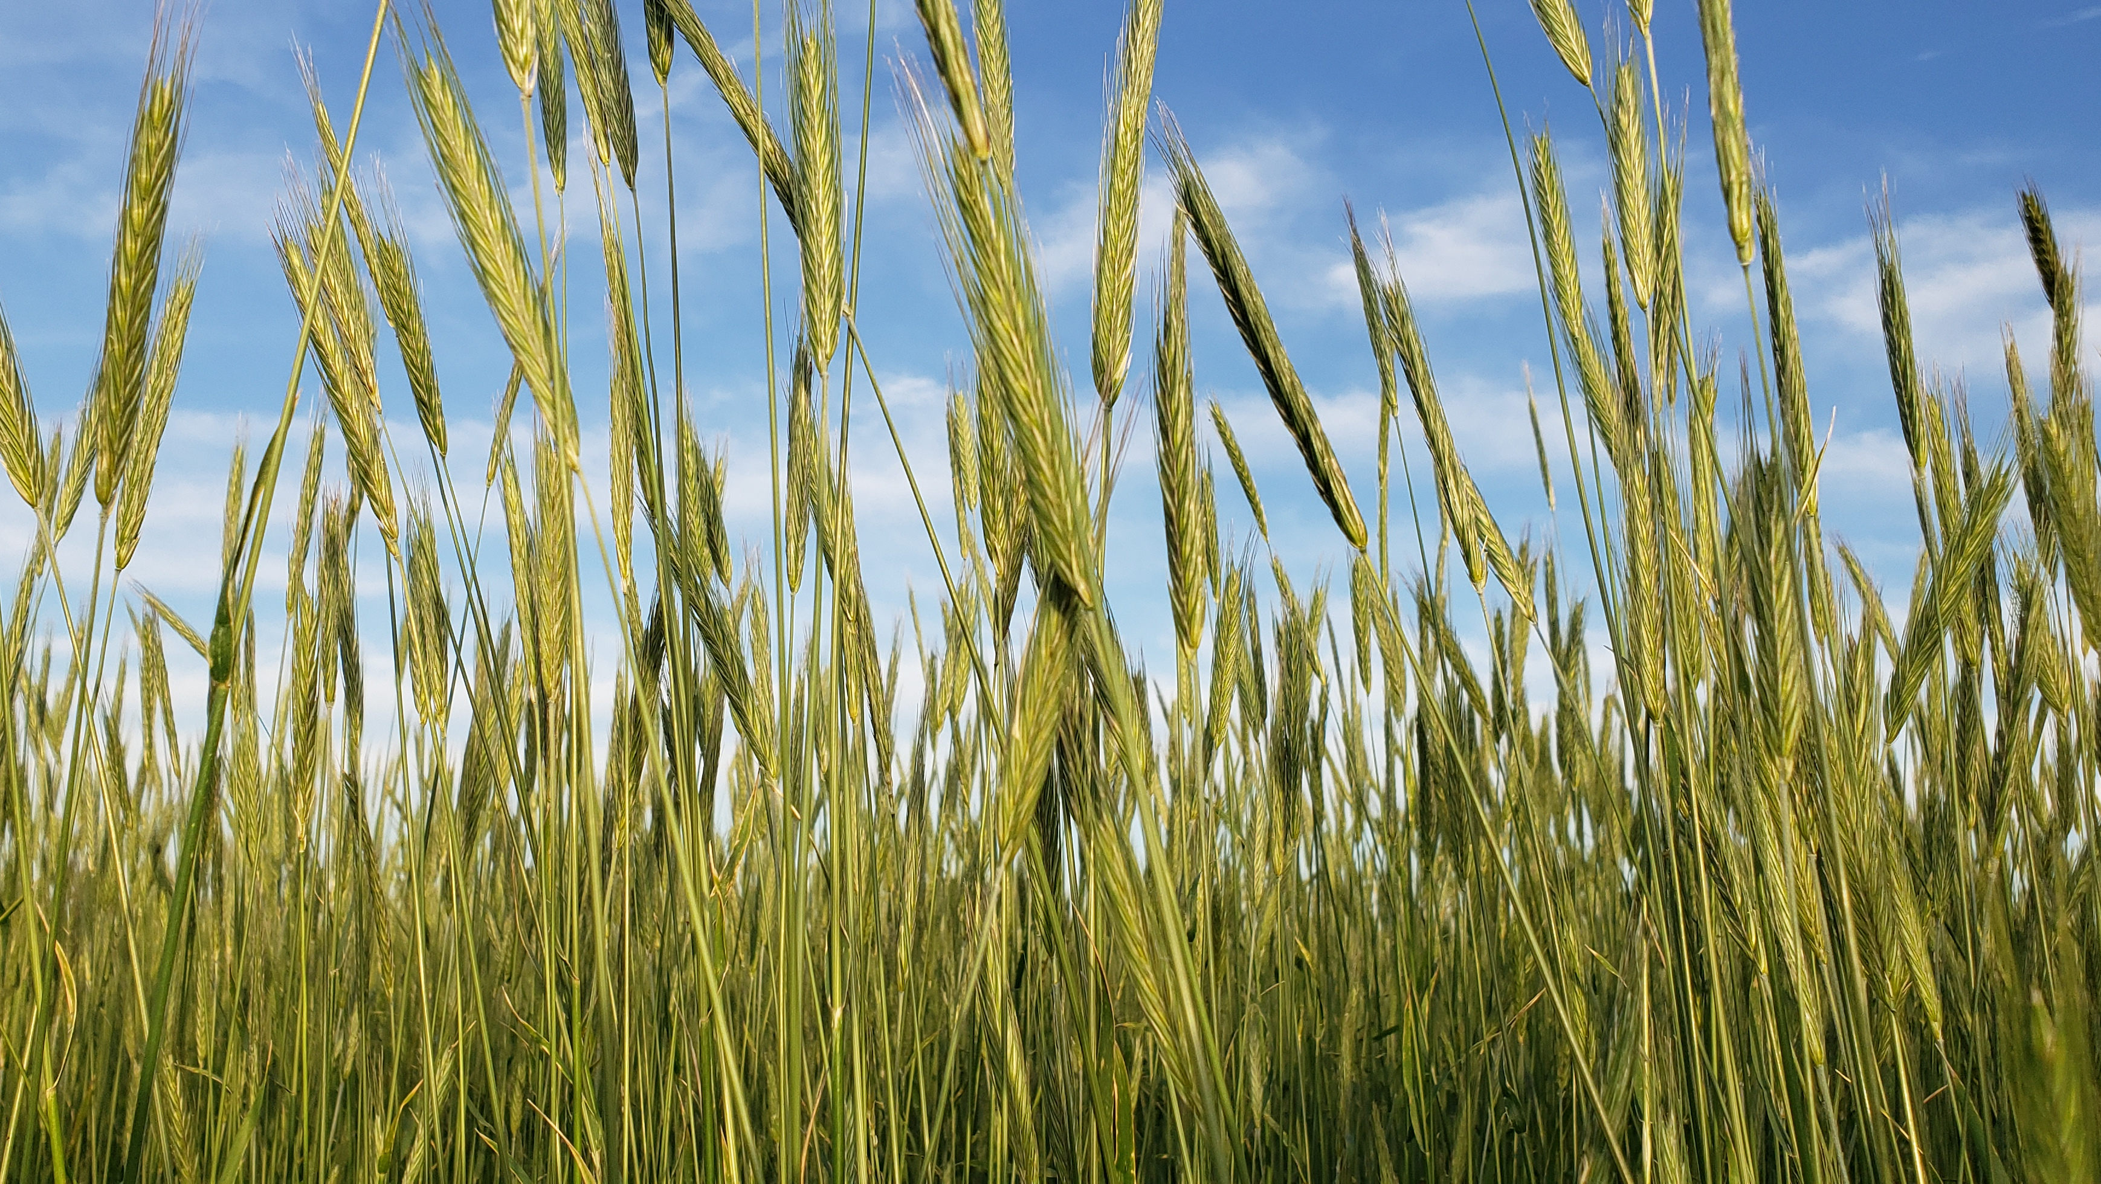
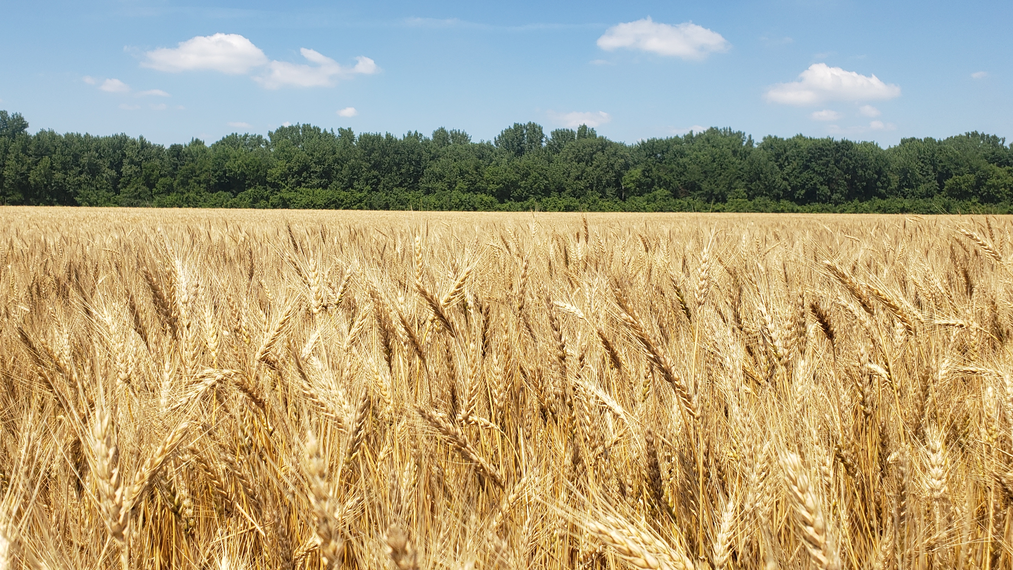
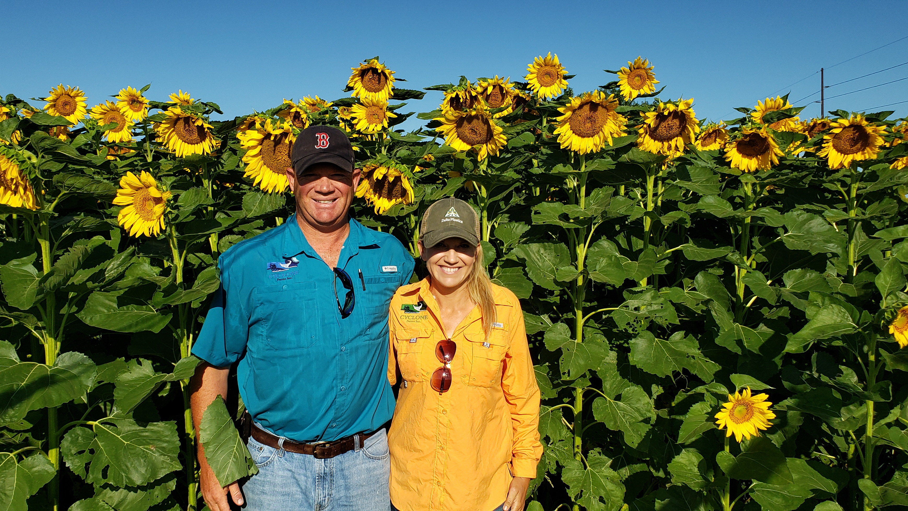
Through Challenge there is Opportunity in Organic Production

